Slide 1
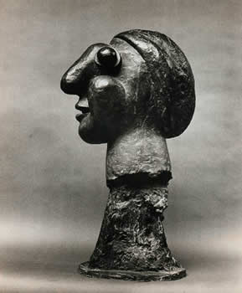
Class 4
From 3D to 2D
and
From 2D to 3D

Slide 2
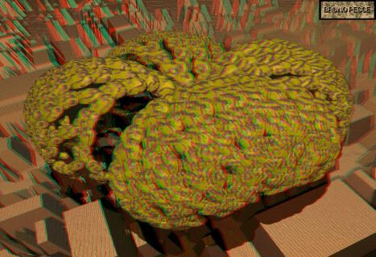
Taken from: http://www.stereoscopy.com/3d-info/

Slide 3
Today - Geometry
Rectified pairs
Triangulation -- 3D from 2D
Correspondence
General pairs

Slide 4







y
image point
x
y
x
Object point
Center of
Projection (COP)
z
principal axis
O
Image
Plane
Left image
Right image
$$o_{r}=(0,0)$$
x
$$o_{l}=(0,0)$$
$x_{r}$
$x_{l}$
$$C_{R}$$
$$C_{L}$$

Slide 5

Depth from Disparity
P
Given $f$, $T$, $x_{l}, x_{r}$
$\frac{{T−x_{l}+x}_{r}}{z−f}=\frac{T}{z}$
Let ${{d=x}_{l} − x}_{r}$
$z=\frac{fT}{d}$
Z
Z-f
O_{L}
O_{r}
x_{l}
x_{r}
f_{l}
p_{l}
p_{r}
f_{r}=f_{l}
T
cop_{l}
cop_{r}

Slide 6

Different Focal Length
Compte $x_{r}^{′}$
$x_{r}^{′}=\frac{f_{l}}{f_{r}}x_{r}$
Let ${{d=x}_{l} − x′}_{r}$
$z=\frac{fT}{d}$
P
Z
x_{r}
p_{r}
x_{l}
x’_{r}
f_{r}
f_{l}
p_{l}
P’_{r}
T
O_{l}
O_{r}

Slide 7
General Case Triangulation
Object Point
Left Image
Right Image
O
+
α
O
β
+
Cop
Cop
Possible to use trigonometry but next class we will use projective geometry
Notes:
When the two image planes and the center of projecions are known, it is possible to compute the 3D location of a point from the two images.

Slide 8
The Parameters of a Stereo System
Intrinsic parameters:
Focal length
Principal point
Scaling
Extrinsic parameters
The relative position and
orientation of the two
cameras
P
f_{r}
O_{r}
f_{l}
β
α
O_{l}
T

Slide 9
Correspondence
Similarity of patches
Geometric constraints:
Epipolar geometry
Global constraints:
Shape smoothness
Order preserving
..

Slide 10
Correspondence
+
+

Slide 11
Epipolar Lines
Left Image
Object point
Cop
Cop
Next class, algebraic formulation:

Slide 12
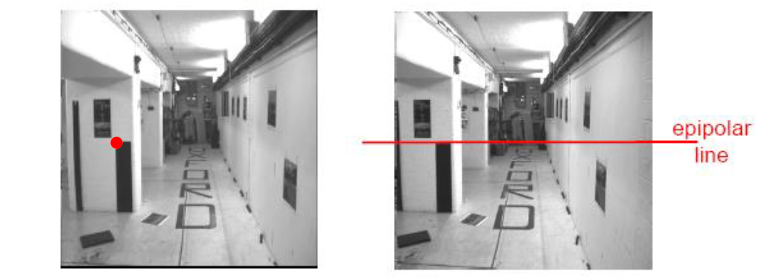
Patch Similarity
Rectified images

Slide 13
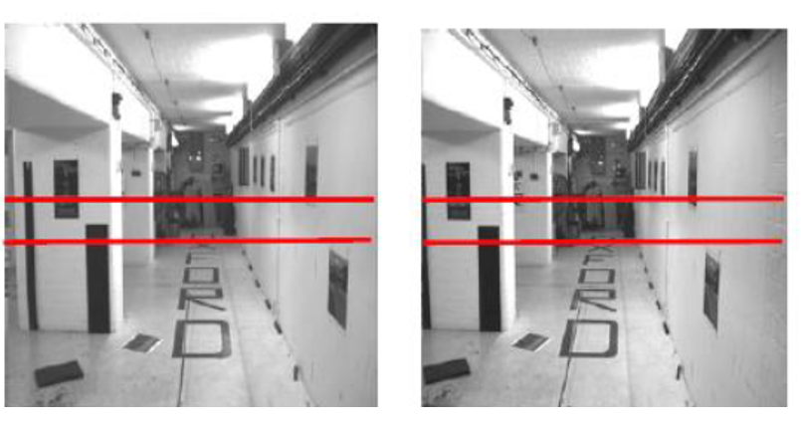
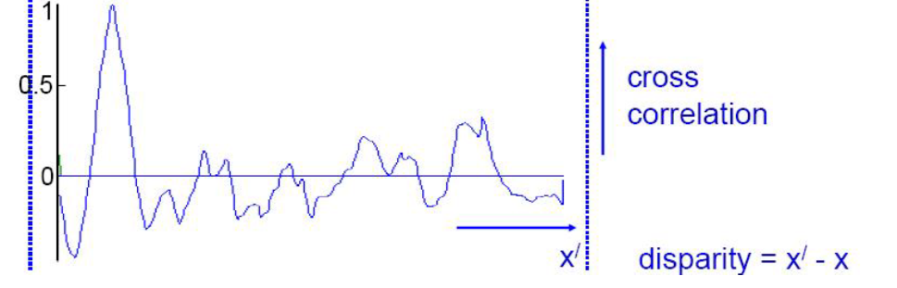
Norm. Cross Correlation

Slide 14
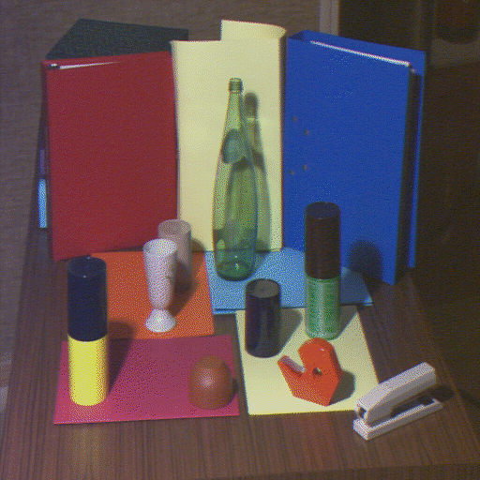
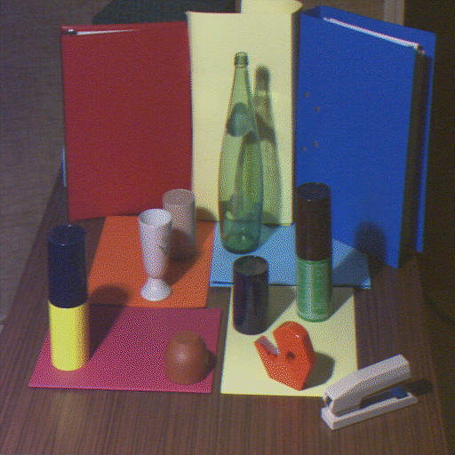
Attribute Constraints
Corresponding points are projection of the 3D point
Color / edge / texture etc.

Slide 15
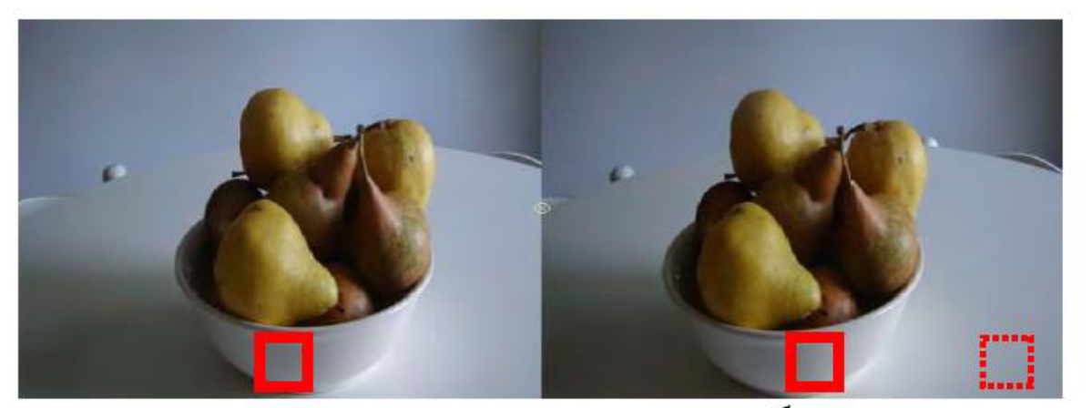
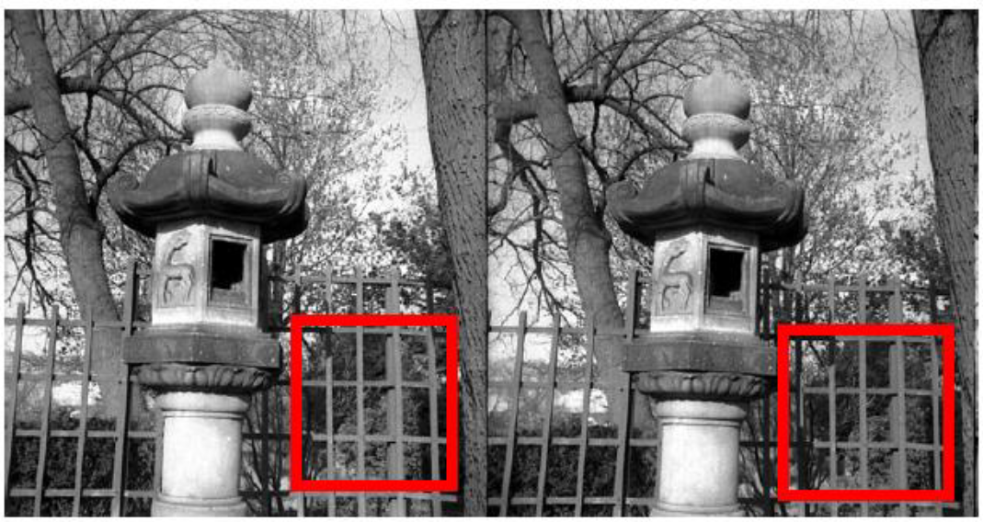
Challenges?

Slide 16
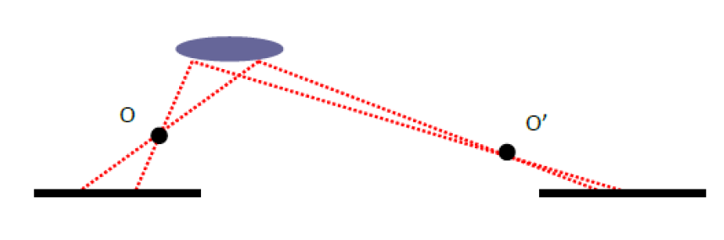
Challenges
Foreshortening effect
Occlusion
Occluded in
Right Image
Occluded in
Left Image
+
+

Slide 17
Uniqueness Constraint
Each pixel can correspond to at most one pixel in the other image
No transparency
No two or more points
project to the same point

Slide 18
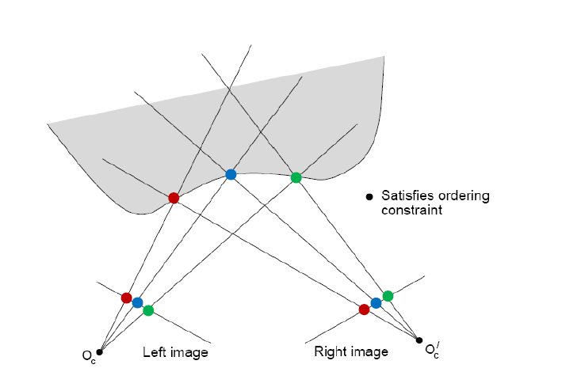
Ordering Constraints
Order along epipolar lines
Corresponding points maintain their order
Not hold when there is a depth discontinuity

Slide 19
Disparity Smoothness Constraint
The disparity changes slowly almost everywhere in the image
True since the depth changes slowly almost everywhere in the 3D scene

Slide 20
Mutual Correspondence Constraint
The existence of a correspondence between points does not depend on whether we start from the left image or the right image

Slide 21
Optimization
1D search
Local greedy matches
Low-level: local attributes of points
2D search:
High-level: Minimizing an energy function that represents global and local properties of the surface (e.g., smoothness)

Slide 22

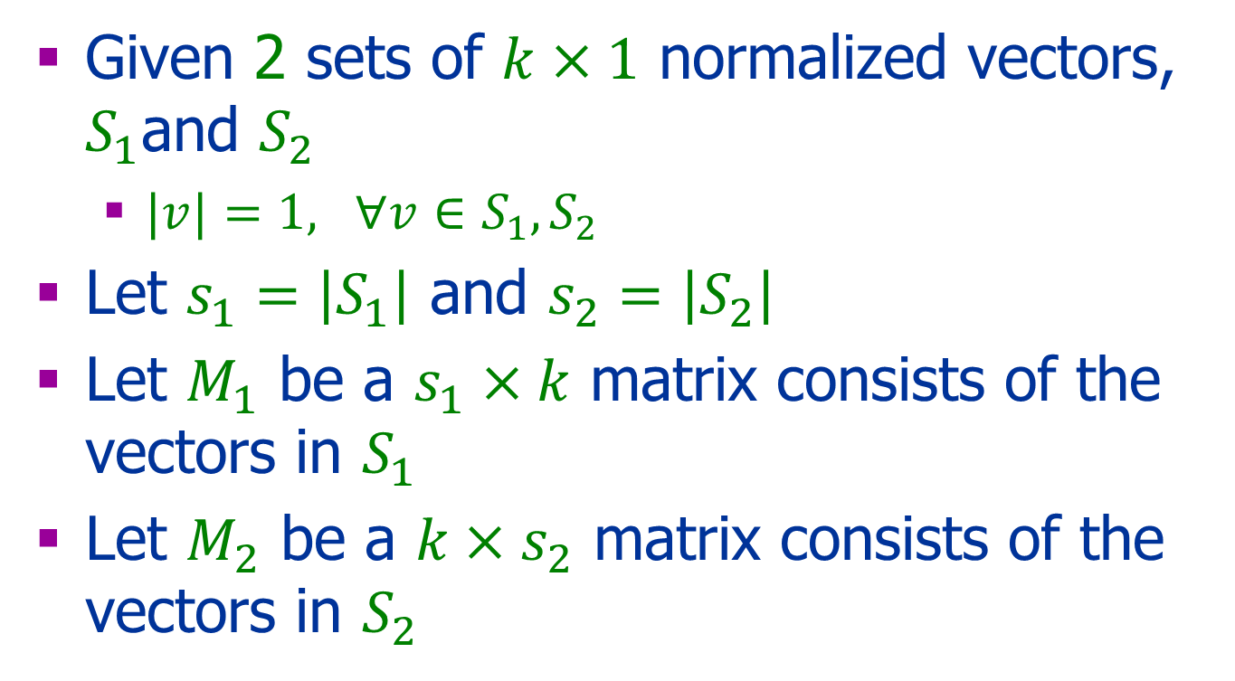

Vectorized Implementation
Given 2 sets of $k×1$ normalized vectors, $S_{1}$and $S_{2}$
$|v|=1, ∀v∈S_{1},S_{2}$
Let $s_{1}=\left|S_{1}\right|$ and $s_{2}=\left|S_{2}\right|$
Let $M_{1}$ be a $s_{1}×k$ matrix consists of the vectors in $S_{1}$
Let $M_{2}$ be a $k×s_{2}$ matrix consists of the vectors in $S_{2}$
$s_{1}×k$
$k×s_{2}$

Slide 23



Vectorized Implementation
Let ${v_{i}∈S}_{1} and$ $u_{j}∈S_{2}$ then $NCC\left(v_{i},u_{j}\right)=v^{T}u$
$C=M_{1}M_{2}$
$C\left(i,j\right)=v_{i}⋅u_{j}$
$${ M}_{1}$$
$${ M}_{2}$$

Slide 24
1D: Dynamic Programing
Right
occlusion
p
Left occlusion
correspondence
t
s
q

Slide 25
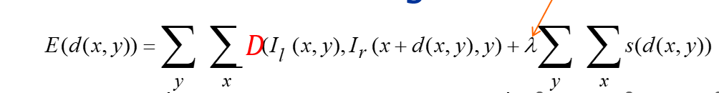

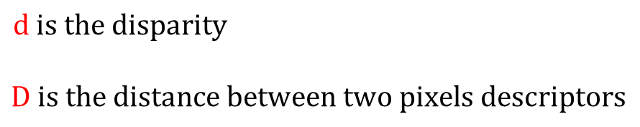
High Level Energy Function
Assume rectified images:
weight
$$D$$
Data Term
Regularization
$$d is the disparity$$
$$D is the distance between two pixels descriptors$$

Slide 26
General Cameras
Object Point
Left Image
Right Image
O
+
α
O
β
+
Cop
Cop

Slide 27
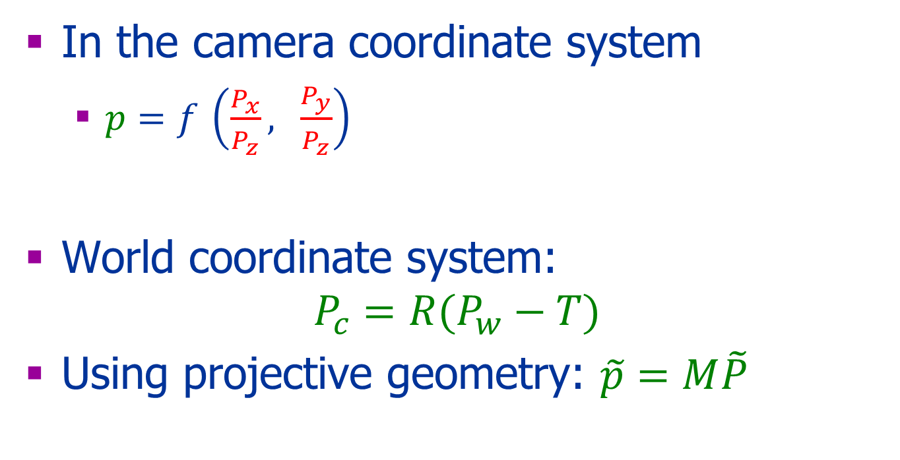



Pinhole Camera: Algebra
y
x
y
x
z

Slide 28
Pinhole Camera: Algebra
y
x
y
x
z

Slide 29
Geometry and Algebra
Point ≡ vector
Line ≡ vector

Slide 30
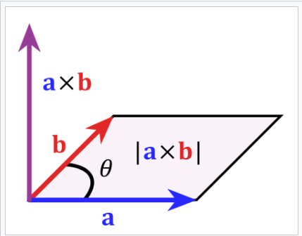
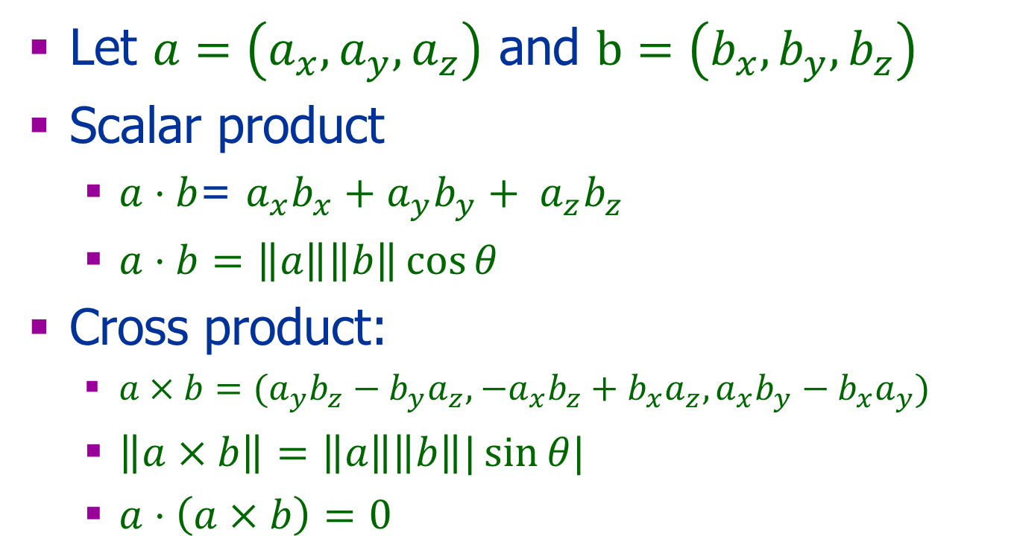
Reminder
Let $a=\left(a_{x},a_{y}, a_{z}\right)$ and $b=\left(b_{x},b_{y}, b_{z}\right)$
Scalar product
$a⋅b$= $a_{x}b_{x}+a_{y}b_{y}+ a_{z}b_{z}$
$a⋅b=\left\|a\right\|\left\|b\right\|\cos{θ}$
Cross product:
$a×b=(a_{y}b_{z}−b_{y}a_{z},$ ${−a}_{x}b_{z}+b_{x}a_{z},a_{x}b_{y}−b_{x}a_{y})$
$\left\|a×b\right\|=\left\|a\right\|\left\|b\right\||\sin{θ|}$
$a⋅\left(a×b\right)=0$

Slide 31
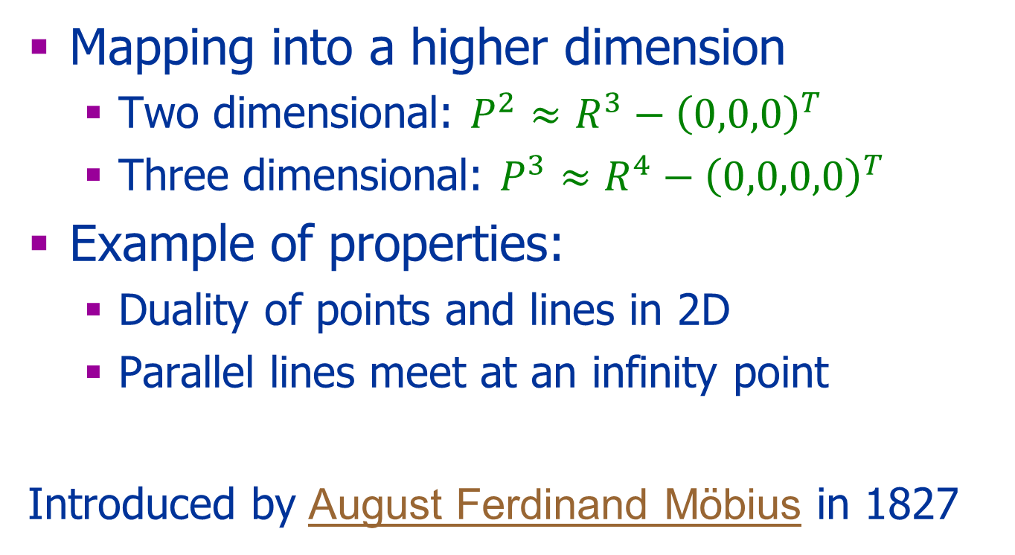
Projective Space
Mapping into a higher dimension
Two dimensional: $P^{2}≈R^{3}−{\left(0,0,0\right)}^{T}$
Three dimensional: $P^{3}≈R^{4}−{\left(0,0,0,0\right)}^{T}$
Example of properties:
Duality of points and lines in 2D
Parallel lines meet at an infinity point
Introduced by August Ferdinand Möbius in 1827

Slide 32
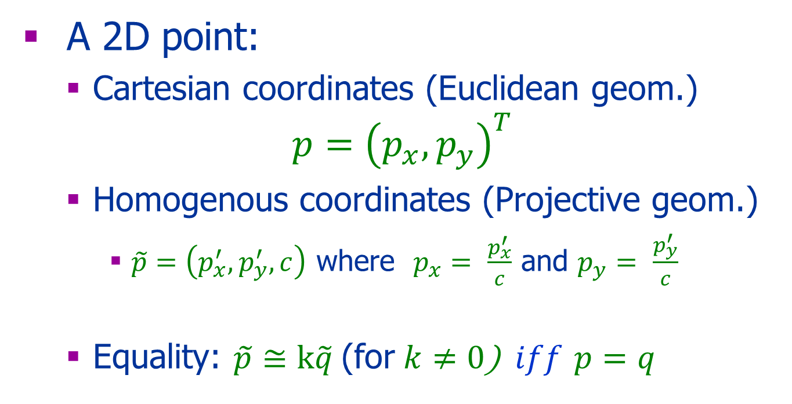
Point
A 2D point:
Cartesian coordinates (Euclidean geom.)
$$p={\left(p_{x},p_{y}\right)}^{T}$$
Homogenous coordinates (Projective geom.)
$\tilde{p}=\left(p_{x}^{′},p_{y}^{′},c\right)$ where $p_{x}=$ $\frac{p_{x}^{′}}{c}$ and $p_{y}=$ $\frac{p_{y}^{′}}{c}$
Equality: $\tilde{p}≅k\tilde{q}$(for $k≠0$) $iff$ $p=q$

Slide 33
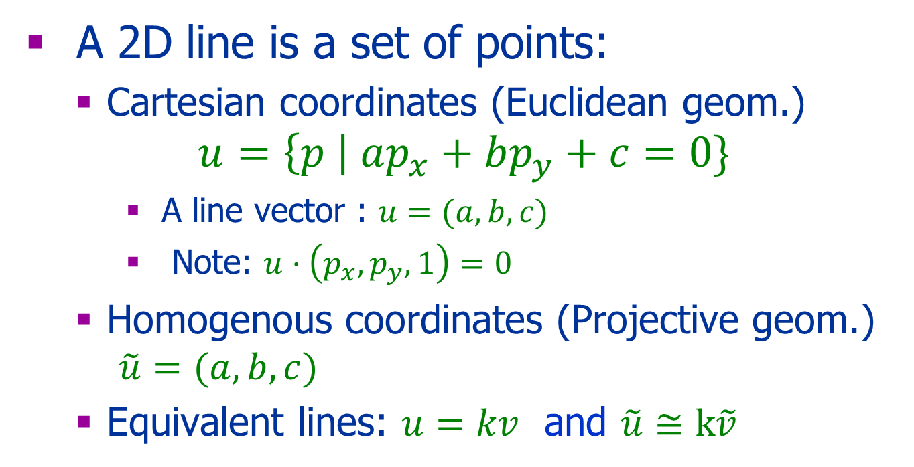
Line
A 2D line is a set of points:
Cartesian coordinates (Euclidean geom.)
$$u=\left\{p \right| ap_{x}+bp_{y}+c=0\}$$
A line vector : $u=(a,b,c)$
Note: $u⋅\left(p_{x},p_{y},1\right)=0$
Homogenous coordinates (Projective geom.) $\tilde{u}=(a,b,c)$
Equivalent lines: $u=kv$ and $\tilde{u}≅k\tilde{v}$

Slide 34
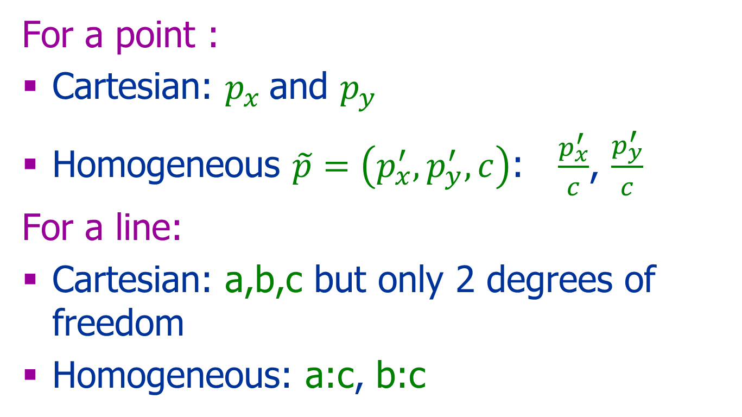
Degrees of Freedom
For a point :
Cartesian: $p_{x}$and $p_{y}$
Homogeneous $\tilde{p}=\left(p_{x}^{′},p_{y}^{′},c\right)$: $\frac{p_{x}^{′}}{c}$, $\frac{p_{y}^{′}}{c}$
For a line:
Cartesian: a,b,c but only 2 degrees of freedom
Homogeneous: a:c, b:c

Slide 35
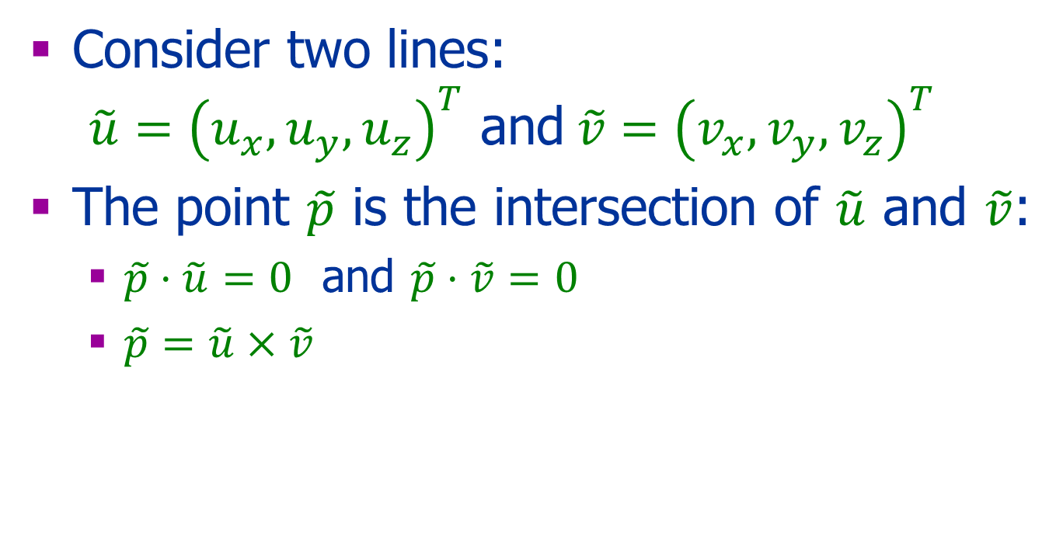
Intersection of lines
Consider two lines: $\tilde{u}={\left(u_{x},u_{y},u_{z}\right)}^{T}$ and$\tilde{v}={\left(v_{x},v_{y},v_{z}\right)}^{T}$
The point $\tilde{p}$ is the intersection of $\tilde{u}$ and $\tilde{v}$:
$\tilde{p}⋅\tilde{u}=0$ and $\tilde{p}⋅\tilde{v}=0$
$\tilde{p}=\tilde{u}×\tilde{v}$
$$\tilde{u}×\tilde{v}={\left(u_{y}v_{z}−u_{z}v_{y},{ u}_{z}v_{x}−u_{x}v_{z},{ u}_{x}v_{y}−u_{y}v_{x}\right)}^{T}$$

Slide 36
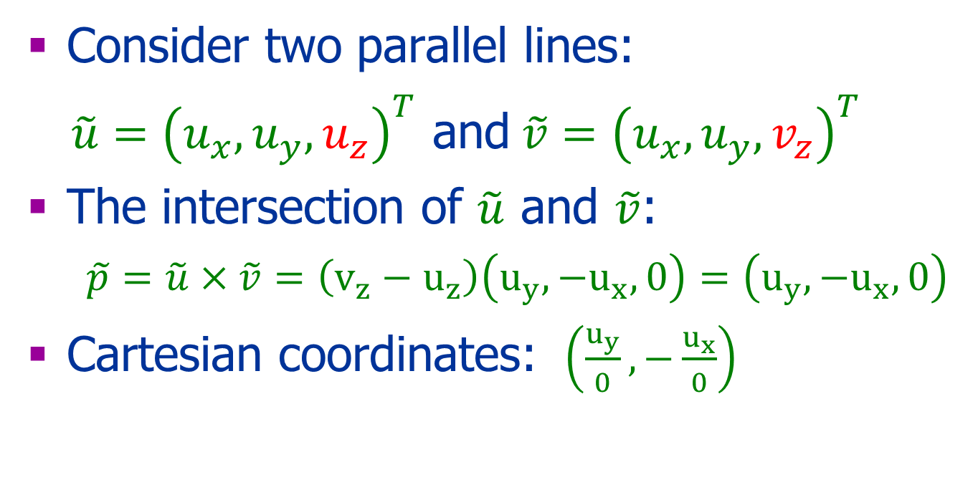
Intersection of Parallel Lines
Consider two parallel lines:
$\tilde{u}={\left(u_{x},u_{y},u_{z}\right)}^{T}$ and$\tilde{v}={\left(u_{x},u_{y},v_{z}\right)}^{T}$
The intersection of $\tilde{u}$ and $\tilde{v}$:
$\tilde{p}=\tilde{u}×\tilde{v}=\left(v_{z}−u_{z}\right)\left(u_{y},−u_{x},0\right)=\left(u_{y},−u_{x},0\right)$
Cartesian coordinates: $\left(\frac{u_{y}}{0},−\frac{u_{x}}{0}\right)$
?
$$\tilde{u}×\tilde{v}={\left(u_{y}v_{z}−u_{z}v_{y},{ u}_{z}v_{x}−u_{x}v_{z},{ u}_{x}v_{y}−u_{y}v_{x}\right)}^{T}$$

Slide 37
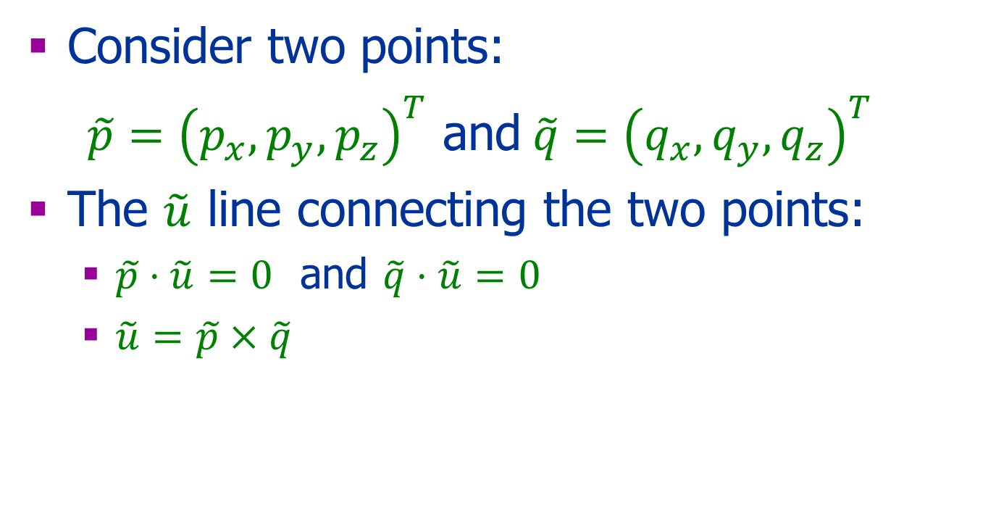
A line through two points
Consider two points:
$\tilde{p}={\left(p_{x},p_{y},p_{z}\right)}^{T}$ and$\tilde{q}={\left(q_{x},q_{y},q_{z}\right)}^{T}$
The $\tilde{u}$ line connecting the two points:
$\tilde{p}⋅\tilde{u}=0$ and $\tilde{q}⋅\tilde{u}=0$
$\tilde{u}=\tilde{p}×\tilde{q}$
$$\tilde{u}×\tilde{v}={\left(u_{y}v_{z}−u_{z}v_{y},{ u}_{z}v_{x}−u_{x}v_{z},{ u}_{x}v_{y}−u_{y}v_{x}\right)}^{T}$$

Slide 38
Addition
Cartesian coordinates: (a,b)+(x,y)=(a+x,b+y)
Homogenoues coordinates P² : (a,b,c)+(x,y,z)=(za+cx,zb+cy,cz)
Homogenoues coordinates P³ :
(a,b,c,d)+(x,y,z,w)= (wa+dx,wb+dy,wc+dz,dw)

Slide 39
Scalar Multiplication
Cartesian coordinates:
x(a,b) =(xa,xb)
Homogenoues coordinates P²:
x(a,b,c) =(xa,xb,c)

Slide 40
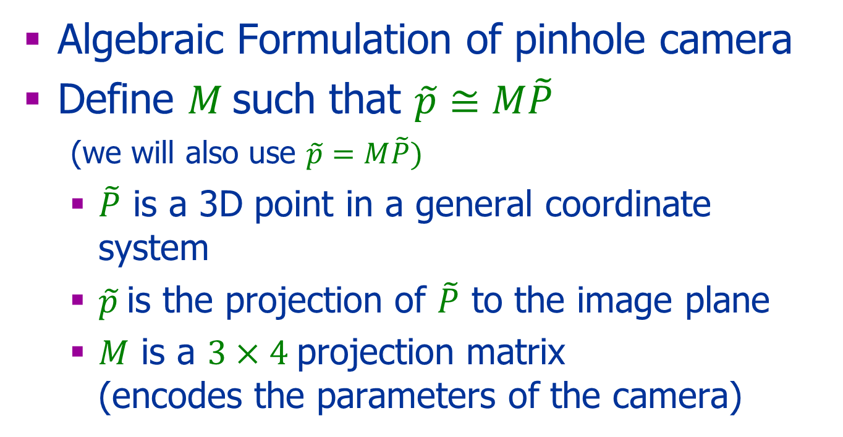
Next
Algebraic Formulation of pinhole camera
Define $M$such that $\tilde{p}≅M\tilde{P}$ (we will also use $\tilde{p}=M\tilde{P})$
$\tilde{P}$ is a 3D point in a general coordinate system
$\tilde{p}$is the projection of $\tilde{P}$ to the image plane
$M$ is a $3×4$projection matrix (encodes the parameters of the camera)

Slide 41
General Coordinate System
y
x
y
y
x
x
y
x
z
Computer Vision by Y. Moses
41

Slide 42
Algebraic Formulation Pinhole Camera

Slide 43
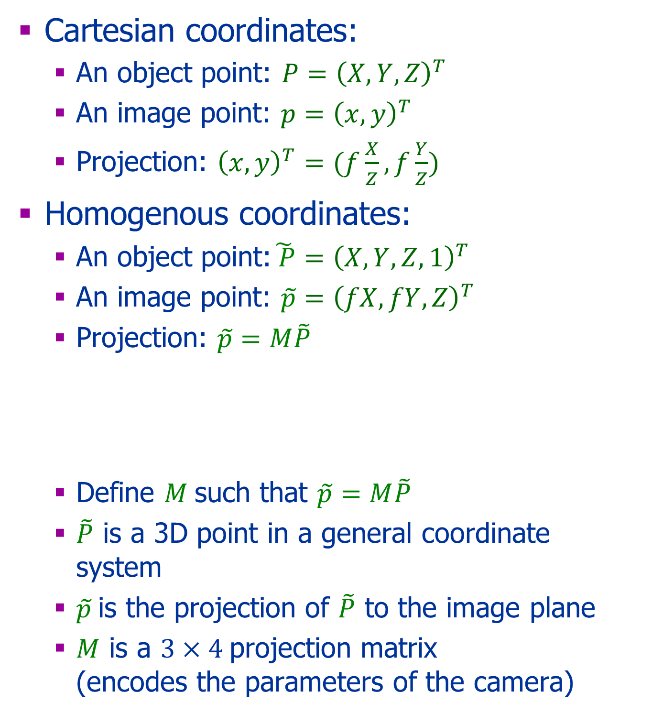


Intrinsic Parameters
Cartesian coordinates:
An object point: $P={\left(X,Y,Z\right)}^{T}$
An image point: $p={\left(x,y\right)}^{T}$
Projection: ${\left(x,y\right)}^{T}=(f\frac{X}{Z},f\frac{Y}{Z})$
Homogenous coordinates:
An object point:$\tilde{ P}={\left(X,Y,Z,1\right)}^{T}$
An image point: $\tilde{p}={\left(fX,fY,Z\right)}^{T}$
Projection: $\tilde{p}=M\tilde{P}$
Define $M$such that $\tilde{p}=M\tilde{P}$
$\tilde{P}$ is a 3D point in a general coordinate system
$\tilde{p}$is the projection of $\tilde{P}$ to the image plane
$M$ is a $3×4$projection matrix (encodes the parameters of the camera)
$$\left(\begin{matrix}x \\ y \\ 1\end{matrix}\right)=\left(\begin{matrix}f & 0 & 0 \\ 0 & f & 0 \\ 0 & 0 & 1\end{matrix} \begin{matrix}0 \\ 0 \\ 0\end{matrix}\right)\left(\begin{aligned}\begin{matrix}X \\ Y \\ Z\end{matrix} \\ 1\end{aligned}\right)$$
$$M$$

Slide 44
Change of Image Coordinates
y
image point
x
Object point
z
Cop
(0,0,0)
y
principal axis
x
principal point
(0,0,f)
(x₀,y₀)

Slide 45
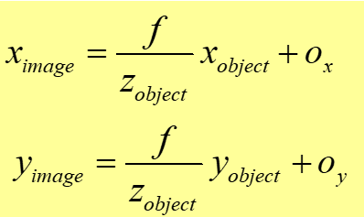
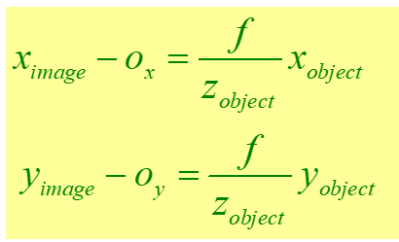
Intrinsic Parameters
O=(o_{x} o_{y})^{T} is the principal point
f : focal length
y
Y_{object}
y_{image}
z_{object}
f
O
o_{y}
x
(0,0)
o_{x,}
Computer Vision by Y. Moses

Slide 46
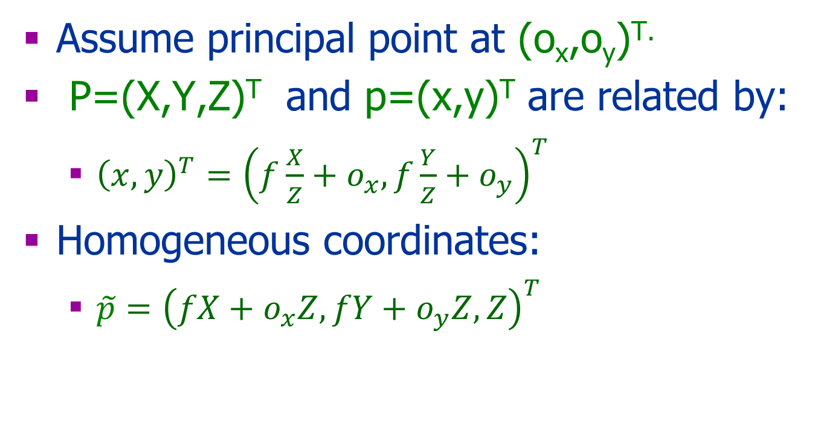

Principal Point Offset
Assume principal point at (o_{x},o_{y})^{T.}
P=(X,Y,Z)^{T} and p=(x,y)^{T} are related by:
${\left(x,y\right)}^{T}={\left(f\frac{X}{Z}+o_{x},f\frac{Y}{Z}+o_{y}\right)}^{T}$
Homogeneous coordinates:
$\tilde{p}={\left(fX+o_{x}Z,fY+o_{y}Z,Z\right)}^{T}$
$$\left(\begin{matrix}x \\ y \\ 1\end{matrix}\right)=\left(\begin{matrix}f & 0 & o_{x} \\ 0 & f & o_{y} \\ 0 & 0 & 1\end{matrix} \begin{matrix}0 \\ 0 \\ 0\end{matrix}\right)\left(\begin{aligned}\begin{matrix}X \\ Y \\ Z\end{matrix} \\ 1\end{aligned}\right)$$

Slide 47
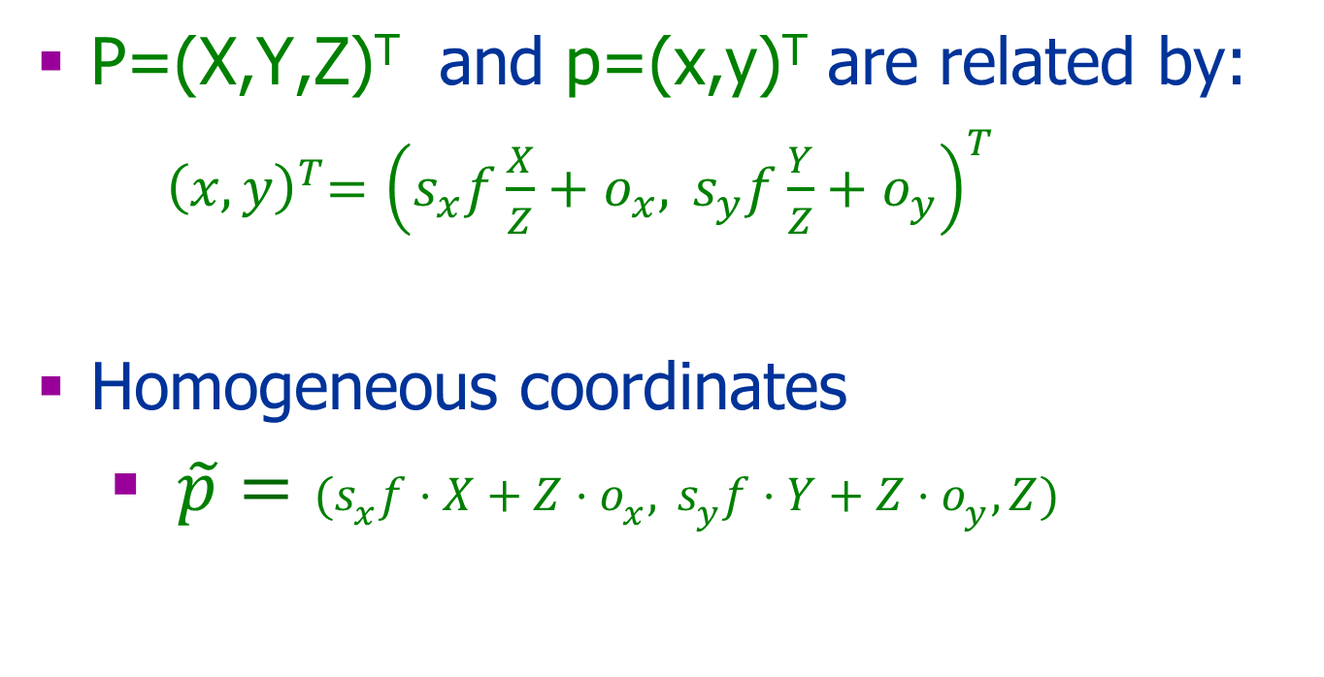
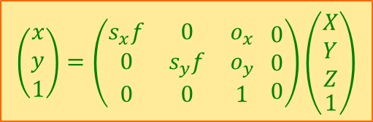
Pixel Scaling
P=(X,Y,Z)^{T} and p=(x,y)^{T} are related by:
${ \left(x,y\right)}^{T}={\left(s_{x}f\frac{X}{Z}+o_{x},{ s}_{y}f\frac{Y}{Z}+o_{y}\right)}^{T}$
Homogeneous coordinates
$\tilde{p}=(s_{x}f⋅X+Z⋅o_{x},{ s}_{y}f⋅Y+Z⋅o_{y},Z)$
$$\left(\begin{matrix}x \\ y \\ 1\end{matrix}\right)=\left(\begin{matrix}s_{x}f & 0 & o_{x} \\ 0 & s_{y}f & o_{y} \\ 0 & 0 & 1\end{matrix} \begin{matrix}0 \\ 0 \\ 0\end{matrix}\right)\left(\begin{aligned}\begin{matrix}X \\ Y \\ Z\end{matrix} \\ 1\end{aligned}\right)$$

Slide 48
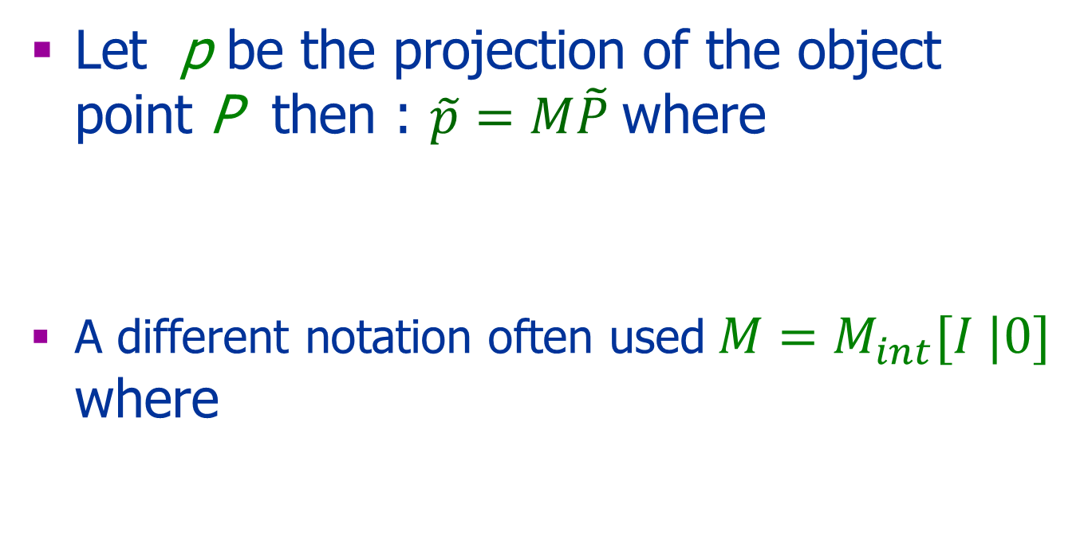


Internal Parameters
Let p be the projection of the object point P then : $\tilde{p}=M\tilde{P}$where
A different notation often used$M=M_{int}[I |0]$ where
$$M_{int}=\left(\begin{matrix}α_{x} & 0 & o_{x} \\ 0 & α_{y} & o_{y} \\ 0 & 0 & 1\end{matrix} \begin{matrix}0 \\ 0 \\ 0\end{matrix}\right)$$
$$M_{int}=\left(\begin{matrix}α_{x} & 0 & o_{x} \\ 0 & α_{y} & o_{y} \\ 0 & 0 & 1\end{matrix} \right)$$

Slide 49

Questions
Assume f=s_{x}=s_{y}=1 and o=(0,0)
What are the projections of:
P1=(0,0,10)^{T} → p1=?
P2=(1,0,5)^{T} → p2=?
P3=(1,0,0.5)^{T}→ p3=?
$$M=\left(\begin{matrix}α_{x} & 0 & o_{x} \\ 0 & α_{y} & o_{y} \\ 0 & 0 & 1\end{matrix} \begin{matrix}0 \\ 0 \\ 0\end{matrix}\right)$$

Slide 50


An Image Pair
Two coordinate systems: left and right.
C_{l}=(0,0,0)^{T} in the left system
C_{r}=(0,0,0)^{T} in the right system
Object Point
Left Image
Right Image
O
f
α
O
β
$$c_{l}$$
$$c_{r}$$

Slide 51
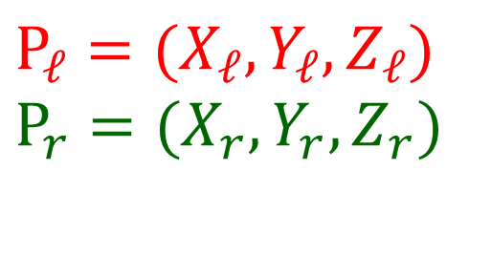
Notation
P P
Object point
p_{l}
+
α
β
C_{L}
+
C_{R}

Slide 52
Change of Camera Coordinates
y
y
x
x
Object point
z
(0,0,0)
Cop
(0,0,0)
principal axis
(x_{c},y_{c},z_{c})
z

Slide 53
3D Rigid Transformation
Given a point in two coordinate systems:
Left coordinate system: P_{world}=(P_{world},Y_{world},Z_{world})^{T}
Right coordinate system: P_{cam}=(X_{cam}Y_{cam} Z_{cam})^{T}
The rigid transformation between the two cameras’ coordinate systems: R, T
Then: P_{cam}= R(P_{world} -T)
Note: this is not the general case of a world coordinate system!

Slide 54
Only Translation In 2D:
y
y
P_{w}=[x_{w} y_{w}]^{T}
P_{cam}= P_{world} - T
P_{c}=[x_{c} y_{c}]^{T}
x
T
x
x
P_{r0}=[0 0]^{T}

Slide 55
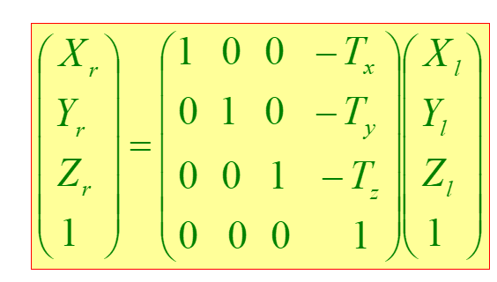
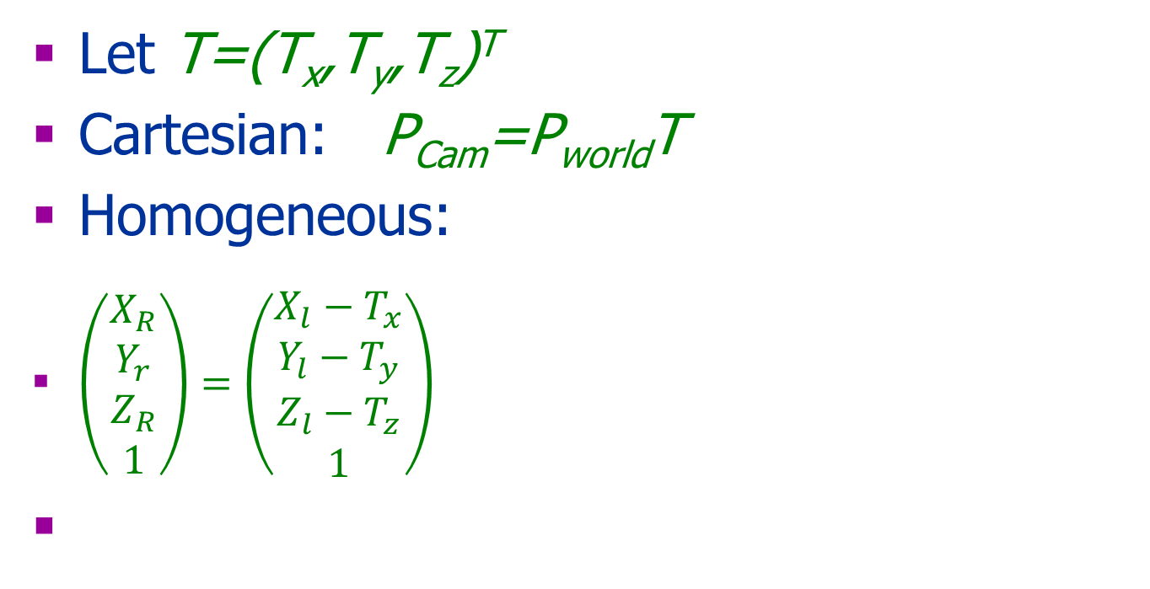

Translation in 3D
Let T=(T_{x},T_{y},T_{z})^{T}
Cartesian: P_{Cam}=P_{world}T
Homogeneous:
$\left(\begin{aligned}\begin{matrix}X_{R} \\ Y_{r} \\ Z_{R}\end{matrix} \\ 1\end{aligned}\right)=\left(\begin{aligned}\begin{matrix}X_{l}−T_{x} \\ Y_{l}−T_{y} \\ Z_{l}−T_{z}\end{matrix} \\ 1\end{aligned}\right)$
$${{\tilde{P}}_{Cam}=M}_{trans}{\tilde{P}}_{world}$$

Slide 56
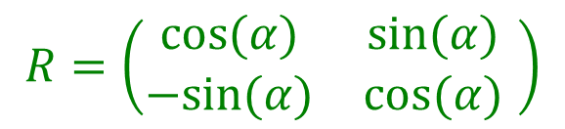
Only Rotation in 2D P_{camera}=RP_{world}
$$R=\left(\begin{matrix}cos⁡(α) & sin⁡(α) \\ −sin⁡(α) & cos⁡(α)\end{matrix} \right)$$
P_{cam}=(x_{r} y_{r})^{T}
y
P_{world}=(x_{l} y_{l})^{T}
y
x
P_{cam}=(0 0)^{T}
α
x
P_{world}=(0 0) ^{T}

Slide 57
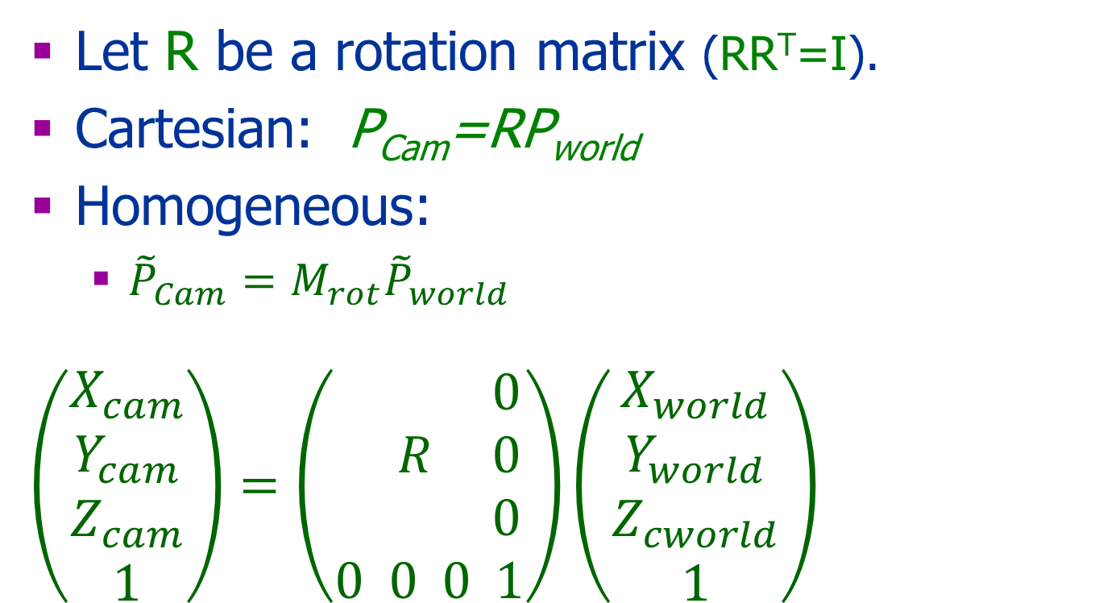
Rotation in 3D
Let R be a rotation matrix (RR^{T}=I).
Cartesian: P_{Cam}=RP_{world}
Homogeneous:
${{\tilde{P}}_{Cam}=M}_{rot}{\tilde{P}}_{world}$
$$\left(\begin{aligned}X_{cam} \\ Y_{cam} \\ Z_{cam} \\ 1\end{aligned}\right)=\left(\begin{aligned} 0 \\ R 0 \\ 0 \\ 0 0 0 1\end{aligned}\right)\left(\begin{aligned}X_{world} \\ Y_{world} \\ Z_{cworld} \\ 1\end{aligned}\right)$$

Slide 58
Translation and Rotation P_{camera}=R(P_{world}-T)
y
P_{world}=[x_{w} y_{w}]^{T}
y
P_{cam}=[x_{c} y_{c}]^{T}
x
x
T

Slide 59
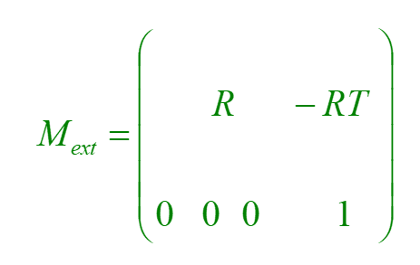
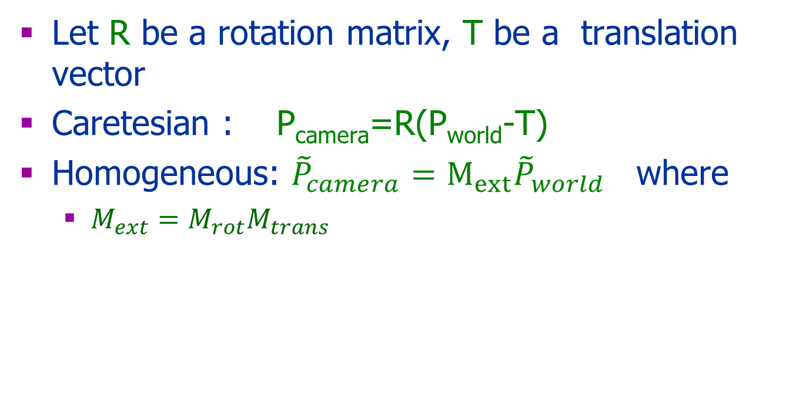
3D Rigid Transformation
Let R be a rotation matrix, T be a translation vector
Caretesian : P_{camera}=R(P_{world}-T)
Homogeneous: ${\tilde{P}}_{camera}=M_{ext}{\tilde{P}}_{world}$ where
$M_{ext}=M_{rot}M_{trans}$

Slide 60
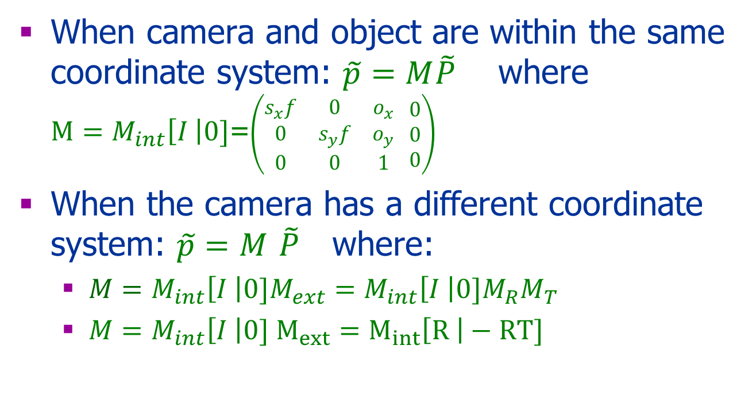
From Camera to Image Coordinate System
When camera and object are within the same coordinate system: $\tilde{p}=M\tilde{P}$ where $M=M_{int}\left[I \right|0]$=$\left(\begin{matrix}s_{x}f & 0 & o_{x} \\ 0 & s_{y}f & o_{y} \\ 0 & 0 & 1\end{matrix} \begin{matrix}0 \\ 0 \\ 0\end{matrix}\right)$
When the camera has a different coordinate system: $\tilde{p}=M$ $\tilde{P}$ where:
$M=M_{int}\left[I \right|0]{M_{ext}=M_{int}\left[I \right|0]M}_{R}M_{T}$
$M=M_{int}\left[I \right|0] M_{ext}=M_{int}\left[R \right|−RT]$

Slide 61
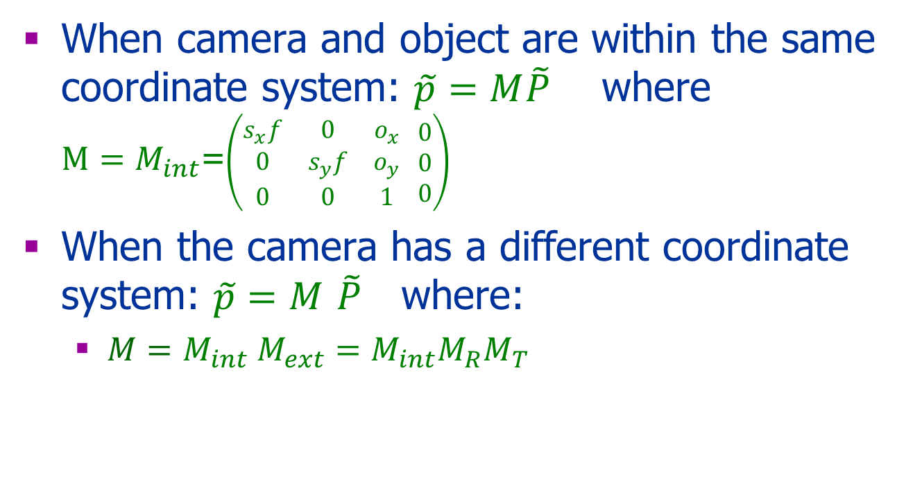
From Camera to Image Coordinate System
When camera and object are within the same coordinate system: $\tilde{p}=M\tilde{P}$ where $M=M_{int}$=$\left(\begin{matrix}s_{x}f & 0 & o_{x} \\ 0 & s_{y}f & o_{y} \\ 0 & 0 & 1\end{matrix} \begin{matrix}0 \\ 0 \\ 0\end{matrix}\right)$
When the camera has a different coordinate system: $\tilde{p}=M$ $\tilde{P}$ where:
$M=M_{int} {M_{ext}=M_{int}M}_{R}M_{T}$

Slide 62
Next
Strereo – general case
Epipolar geometry
Rectification
Other type of stereo images
Homography
RANSAC

